Slide 1
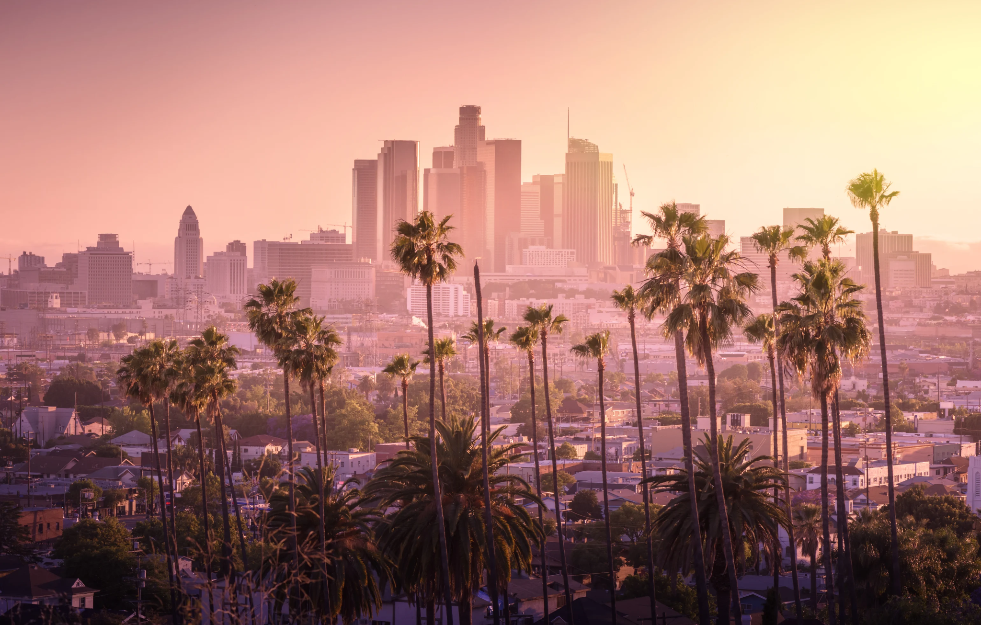

MODELING MEGA EVENTS
TRAFFIC DURING THE 2028 OLYMPIC GAMES
UCLA STATS 421 Group 6
Chris, Nils, Sungjin, Jeremy, Dan, Hochan

Slide 2
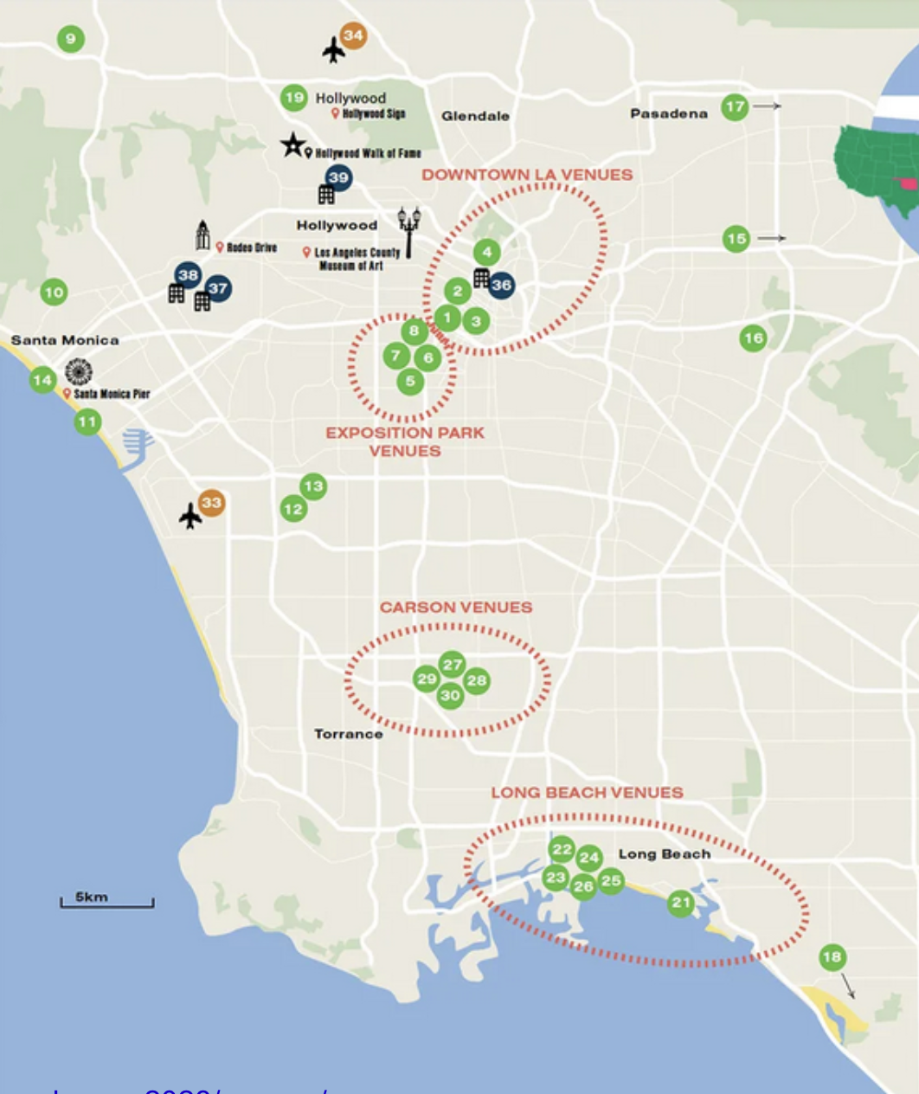
2028 Olympic Games
The 2028 Olympics will take place in greater Los Angeles.
This will strain all local transportation networks.
Forecasting traffic will help local governments, Olympic organizers, and you!
Image Source: https://www.roadtrips.com/summer-games/los-angeles-packages-2028/venues/
Locations of Olympics Source: https://la28.org/en/games-plan/venues.html
Notes:
voice : https://drive.google.com/file/d/1mdc-XaW3OnLMvmWW79Gopy4qhqGFv0uy/view?usp=drive_link

Slide 3
Methodology
1
2
3
4
Identify a high-traffic event in LA
Collect high resolution traffic data
Analyze traits of high-volume event traffic
Model traffic conditions for the Olympics
Notes:
Chris

Slide 4
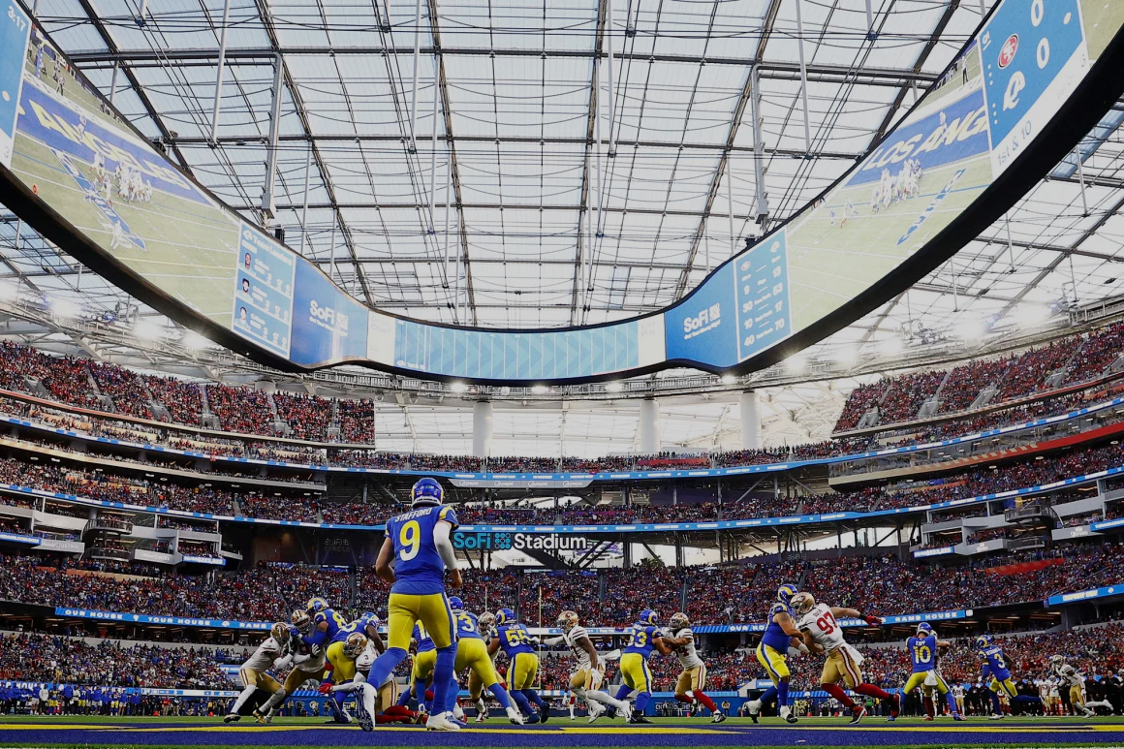


SUper Bowl Week 2022
Super Bowl Week in LA drew over 100,000 new visitors (77% increase over normal tourism).
Numerous fan and marketing events are held across the host city.
Notes:
Chris

Slide 5

Performance Measurement System (PeMS)
 | Description | Format
Station | Sensor Station ID | Primary Key/Unique ID
Timestamp | Observation Time | YYYY/MM/DD HH:MM:SS
District | District 7 (Los Angeles) | Numeric
Percentage Observed | 5-minute lane points that were observed | Percentage
Average Speed | Flow-weighted average of 5-minute station speeds | Miles Per Hour (mph)
Average Occupancy | Average of 5-minute station occupancies over the hour | Percentage
Total Flow | Sum of 5-minute flows / hour | Cars per Hour
Latitude / Longitude: | Station Location | Foreign Key
* https://dot.ca.gov/programs/traffic-operations/mpr/pems-source
Notes:
Nils: Video source: https://drive.google.com/file/d/1VPR-0Z-NFu6smWrdrkxKoYWieA63OSMq/view?usp=drive_link
Before going any further, I just want to take a quick moment to acknowledge Lucy, one of our program members, who was kind enough to help us with the data collection for this project. Her contribution really allowed us to dive deep into the forecasting side of our analysis.
The dataset we used is the Caltrans Performance Measurement System, or PEMS for short. This system continuously collects real-time traffic data from thousands of sensors placed along California’s highways.
While the dataset contains a wide variety of variables, we focused on the most pivotal ones shown here.
Since our project is centered on the Los Angeles metropolitan area, we restricted our data to District 7, which encompasses nearly all major highways between Santa Clarita in the north and Long Beach in the south.
Among the key features, we have Percentage Observed, which measures the share of five-minute lane points that were successfully recorded at each station. This essentially gives us a sense of how complete or reliable the data collection is for a given time window.
Then there’s Average Speed, which is the flow-weighted average of vehicle speeds across all lanes at a station — pretty intuitive, but very important for understanding traffic dynamics.
We also have Average Occupancy, which captures how long detectors were covered by vehicles — in other words, how congested a particular stretch of roadway is at a given time.
And finally, Total Flow, which records the number of vehicles passing by a station per hour — a direct indicator of traffic volume.
Now, I’ve skipped over some of the other fields here because I want to briefly highlight how these Caltrans sensor stations function. They’re embedded all across the state’s highway network and continuously report time-stamped, geo-tagged traffic readings. The real value for us comes from these timestamps and precise locations — they let us map and analyze geographic patterns in LA traffic.
For instance, we can detect spikes in flow or occupancy around specific events — like traffic surges toward SoFi Stadium during the Super Bowl.

Slide 6
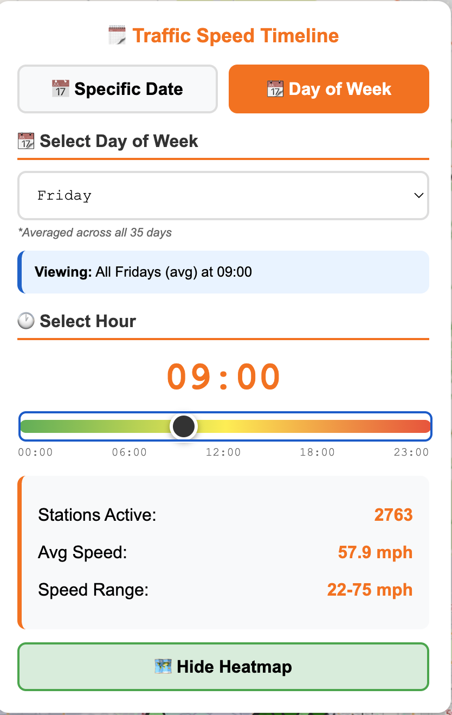
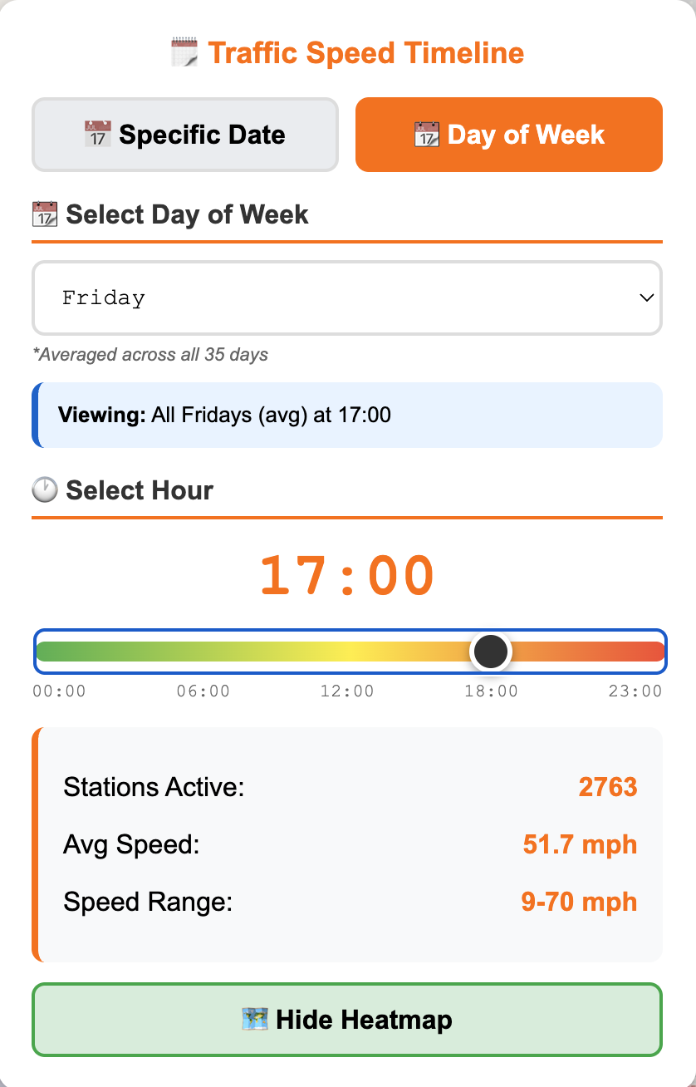
Normal Traffic Conditions
Friday 8-9 AM
Friday 4-5 PM
Notes:
Nils
Here on the left you can see an animation on the average speed of traffic on a normal friday in los angeles with darker dots indicating a decline in average speed near that station at the given timestamp. As you can see, the largest slowdowns of traffic are witnessed during the morning and evening rush hour windows, between 8-9AM and 4-5PM respectively. Also note the low end of the speed range during evening rush hour, capturing that stop and go behavior we all know in love with an average speed of 9 miles an hour.

Slide 7
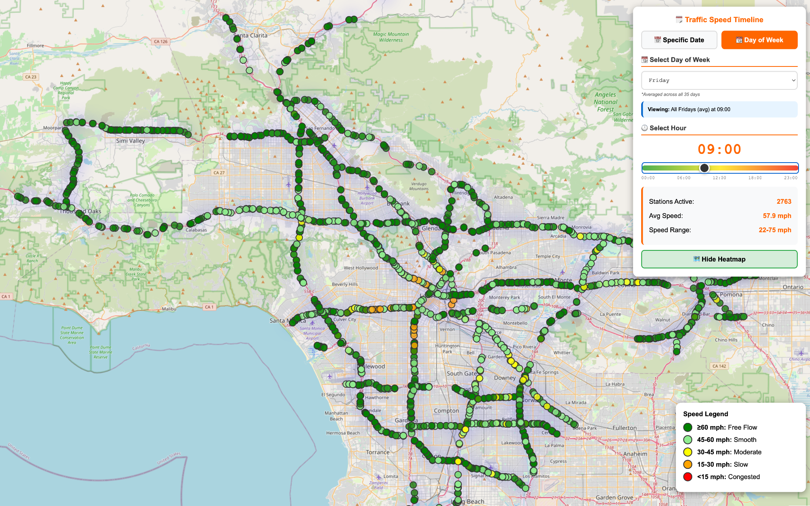
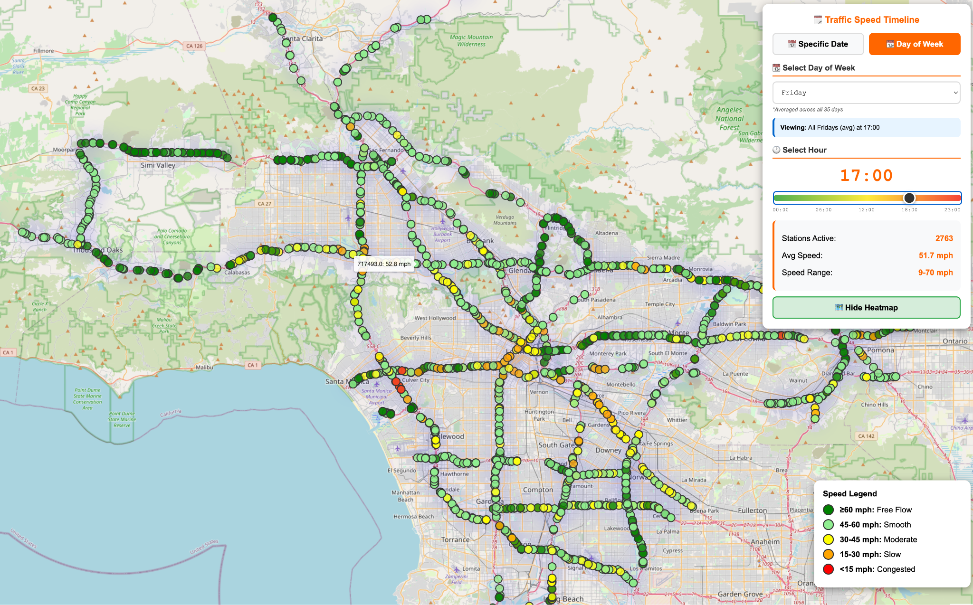
Normal Traffic Conditions
Interactive Map
Friday 8-9 AM
Friday 4-5 PM
Notes:
Nils
In these graphics, we get a better understanding of which are the most congested stations during the morning and evening rush hour windows. As we all could have guessed, the stations near the intersection of the 10 and 405 witness the greatest slowdowns of any of the stations in district 7. At a close second, we have all major arteries flowing to and from downtown los angeles.

Slide 8
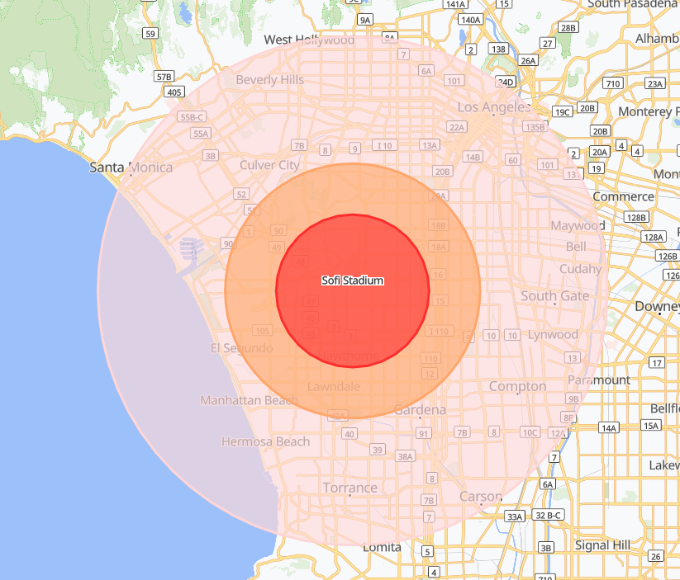
SUPER BOWL TRAFFIC Analyzed
Event data base on 2022 Super bowl
Event Date: Feb 13, 2022 (Sunday)
Grouping Stations:
R1 - 3 miles
R2 - 5 miles
R3 - 10 miles
Control: “Normal Sundays” 2-3 weeks later
Purpose: Event vs. Normal Traffic patterns
Notes:
Sungjin

Slide 9
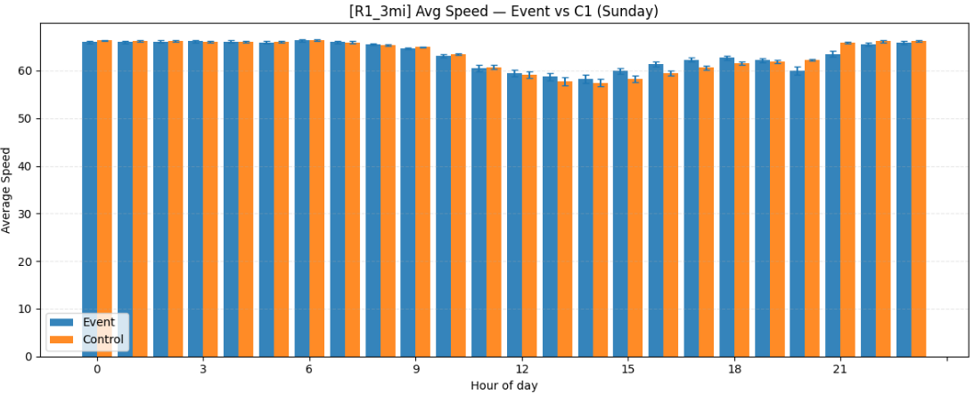
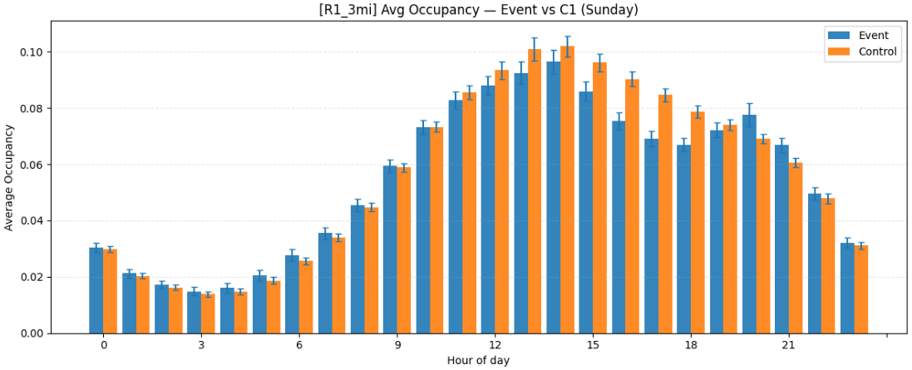
SUPER BOWL TRAFFIC Analyzed
Radius | Peak Congestion | Speed Δ (mph) | Occupancy Δ
3 miles | 9 PM | -2.40 | +0.01
5 miles | 9 PM | -3.10 | +0.01
10 miles | 9 PM | -2.66 | +0.01
Notes:
Sungjin

Slide 10
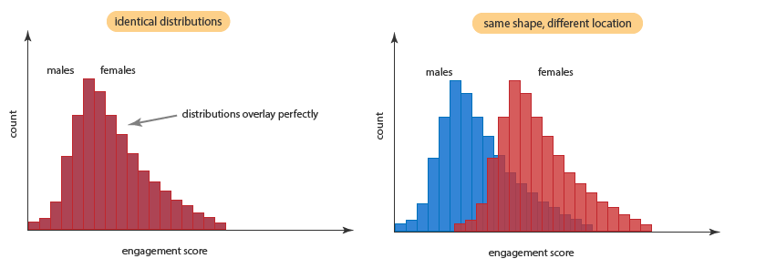
Where can we see Differences?
Mann-Whitney U Test
Comparing two days to their regular counterparts
Friday (non-event day)
Sunday (Super bowl)
Average Occupancy
Notes:
Jeremy

Slide 11
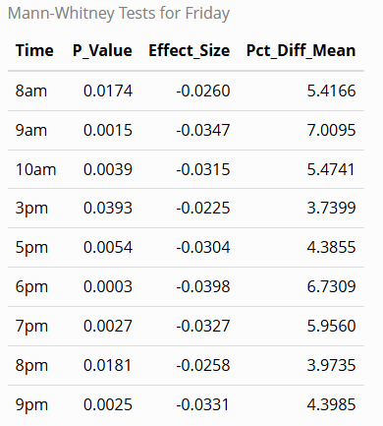
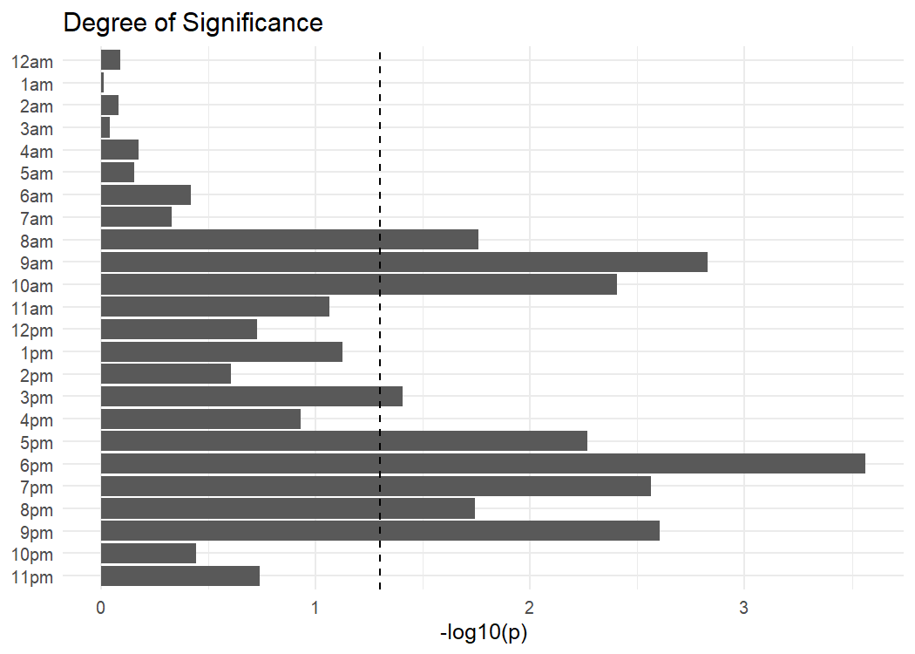
Mann-Whitney for friday
Notes:
Jeremy

Slide 12
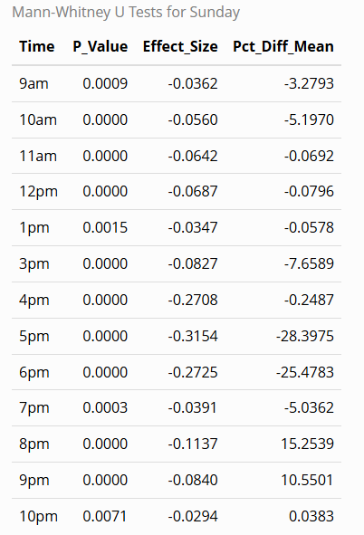
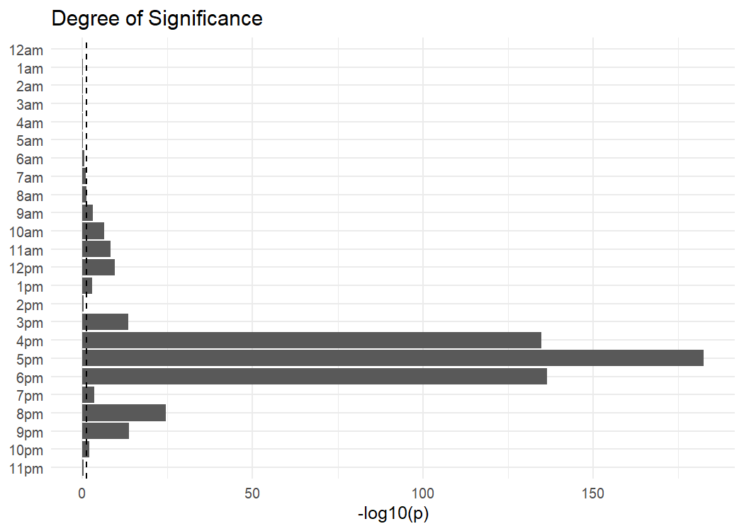
Wilcoxon Test for Sunday
Notes:
Jeremy
On Super Bowl Sunday afternoon around 5pm to 6 pm , road occupancy dropped by nearly one-third. Essentially, ~30% fewer vehicles were on the road.

Slide 13
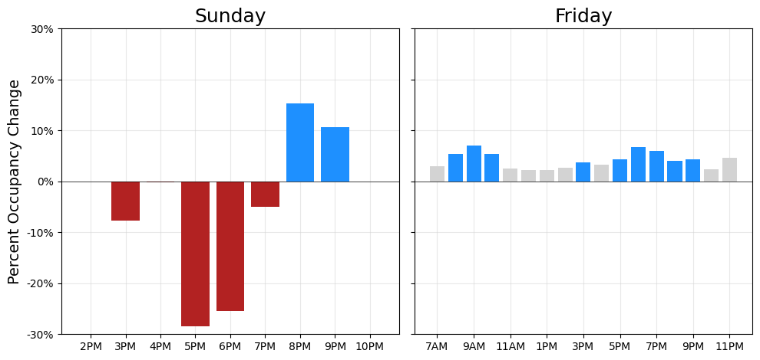
Results
Large, 20-30% effect Sunday evening (during/after the event).
Smaller 3-7% effect on normal rush hour traffic.

Slide 14
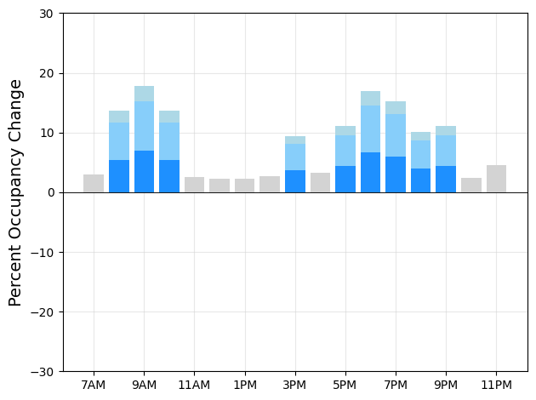
Olympics Forecasting
~130k Super Bowl visitors.
~300-400k daily visitors for the 2024 Paris Olympics.
Assuming ~100k normal tourism in major cities.
30-75% more total visitors (1.5-2x event-specific)

Slide 15
Limitations and Assumptions
Population Changes
Public Transit
Localized Impact
Unique Factors
Projecting demographic changes, etc. before 2028.
New public transit options will be available for the Olympics.
Super Bowl traffic focused at Sofi Stadium and Inglewood area.
Los Angeles is unique, unlike past Olympic host cities.
Notes:
1. public transit.
LA is investing heavily in new transit infrastructure
by 2028—new bus transit, expanded light rail stations.
This could significantly reduce car travel during the Olympics.
Our model assumes current transit capacity,
so the actual traffic impact might be lower than
our forecast shows.
2. venue concentration.
The Super Bowl was localized. Sofi, Inglewood.
The Olympics span 20+ venues across Los Angeles—
Downtown, Long Beach, Carson, and even Santa Monica.
3., we're projecting forward to 2028.
Population, demographics, housing, and community might shift significantly.
We don't have a crystal ball.
4., LA is unique.
CAR It's invaluable, and
unlike Paris or Tokyo. LA presents unique challenges

Slide 16
NExT Steps
Other Cities
Localized Impact
Time-Series Analysis
Incorporate detailed traffic data from past host cities.
More granular predictions for areas, Metros, and streets.
Use time-series methods to capture traffic behaviors.
*https://storymaps.arcgis.com/stories/5266177c064d4ef2adf4c5088445c6da **https://www.dropbox.com/scl/fo/lx4rqn21oanibe0lfc2ov/AIGhXzOXcRo8uSEmZiiQeM8/_Executive%20Summaries?e=1&preview=Metro_Vision2028_Plan_ExecSummary_English.pdf&rlkey=teex9wmqu97kyh3um5iip6ul4&subfolder_nav_tracking=1&dl=0
Notes:
1. other Olympic host cities.
Paris 2024 just happened. By analyzing how traffic changed in those cities
, we can build confidence in our scaling assumptions
2. Get more granular.
Right now we're looking at LA County broadly.
We need to zoom in on specific corridors
I-405, I-10, the 101—and predict traffic changes
street-by-street and freeway-by-freeway.
That's where city planners actually need the data.
3 Use time-series forecasting.
Methods like ARIMAX or even machine learning
can capture the temporal dynamic
how traffic builds up over the 16-day window,
how it peaks and falls. This accounts for things like cumulative visitor arrivals
and behavioral adaptation.

Slide 17
References
Image Source: https://www.roadtrips.com/summer-games/los-angeles-packages-2028/venues/
Locations of Olympics Source: https://la28.org/en/games-plan/venues.html
Data source: https://dot.ca.gov/programs/traffic-operations/mpr/pems-source
World Population Review: https://worldpopulationreview.com/us-cities/california/los-angeles
Paris's Website: https://www.paris.fr/en/pages/paris-2024-games-11-2-million-visitors-to-greater-paris-28160
Paris Population Data: https://www.macrotrends.net/global-metrics/cities/20985/paris/population
Paris's "Barometer" Tourism Service: https://parisjetaime.com/eng/media/article/preliminary-report-olympic-games-a1755
LA Metro Vision 2028 Plan Exec Summary: https://www.dropbox.com/scl/fo/lx4rqn21oanibe0lfc2ov/AIGhXzOXcRo8uSEmZiiQeM8/_Executive%20Summaries?dl=0&preview=Metro_Vision2028_Plan_ExecSummary_English.pdf&rlkey=teex9wmqu97kyh3um5iip6ul4&subfolder_nav_tracking=1
Public Transportation in LA: https://storymaps.arcgis.com/stories/5266177c064d4ef2adf4c5088445c6da
Credits (Github repo):
Liyaguang:https://raw.githubusercontent.com/liyaguang/DCRNN/refs/heads/master/data/sensor_graph/graph_sensor_locations.csv
Llenmann: https://github.com/llennemann/los-angeles-traffic-forecasting

Slide 18
Questions Feedback
?

